Slide 1

Relief Management System
Presented By
Bhatt, Meghanshu - 002961585
Khanna, Raghav - 001088094
Tiwari, Arjun Nandkishor - 002176236

Slide 2
About Ecosystem
The purpose of the Relief Management System is to provide essential needs to the people who are in crisis. Additionally, this application also organizes and manages the resources and responsibilities of each operational unit in humanitarian emergencies.

Slide 3
Problem Statement
Today's world is being influenced by crises on a large scale. Emergency situations can have severe health, economic, political, and societal effects, both in the short and long term. They significantly impact community health and well-being, health system resilience, national economic stability, and progress toward the Sustainable Development Goals.

Slide 4
Extra Features
The location of the organization can be set up by the organization’s admin
System admin can see all the organizations for that network across the map
Admin can monitor work request flow via graph for that network, across enterprises

Slide 5
Roles & Capabilities
System Admin Role
The responsibility of this role is to create enterprises, networks and enterprises accounts.
Hospital Admin Role
The responsibility of this role is to create clinic and blood bank organizations, manage employees and create user accounts

Slide 6
Roles & Capabilities
Service Provider Admin Role
The responsibility of this role is to create food and shelter organization, manage user accounts and employees
NGO Admin Role
To set up NGO information and can request Donation and Clinic Organization

Slide 7
Roles & Capabilities
Donation Admin Role
The responsibility of this admin is to handle requests from NGO organizations
Emergency Admin Role
The responsibility of this admin is to create emergency organizations like fire and police, manage its employees and create user accounts

Slide 8
Roles & Capabilities
Community Admin Role
This admin is the end-user and its responsibility is to request different available aid on behalf of its people.
Distributor Admin Role
The responsibility of this admin is to produce food, manage food-related requests from food organizations and set up organizational information

Slide 9
Roles & Capabilities
Clinic Admin Role
The responsibility of this admin is to manage requests from communities and NGOs, user accounts and create doctors for that clinic
Doctor Admin Role
The responsibility of this admin is to manage patient requests from communities

Slide 10
Roles & Capabilities
Blood Bank Admin Role
The responsibility of this admin is to manage different blood types and requests from communities
Food Admin Role
The responsibility of this admin is to manage community food requests and food inventory

Slide 11
Roles & Capabilities
Shelter Admin Role
The responsibility of this admin is to make shelter and manage shelter requests from communities
Police Admin Role
The responsibility of this admin is to create different types of police and manage emergency requests from communities

Slide 12
Roles & Capabilities
Fire Admin Role
The responsibility of this admin is to aid the community with an emergency request like a fire

Slide 13
Key Functionality
A transparent system where the admin can monitor all the work requests
Cross network communication with an ability to seek help from other networks in case of resource full

Slide 14
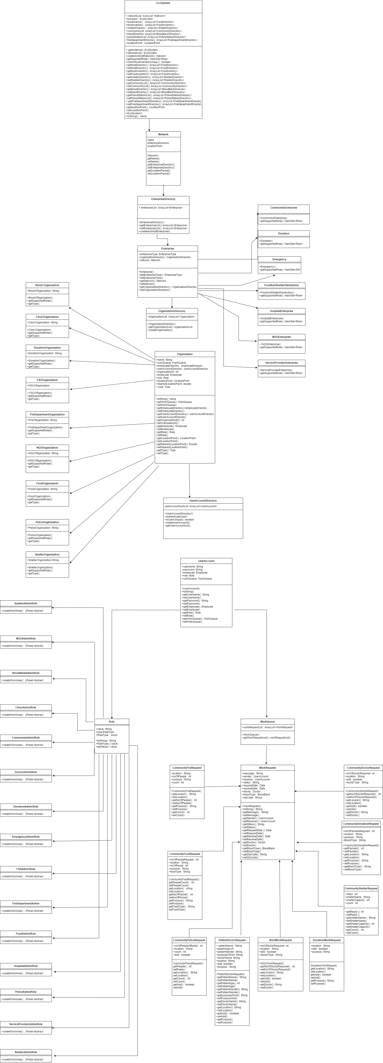
UML Diagram

Slide 15
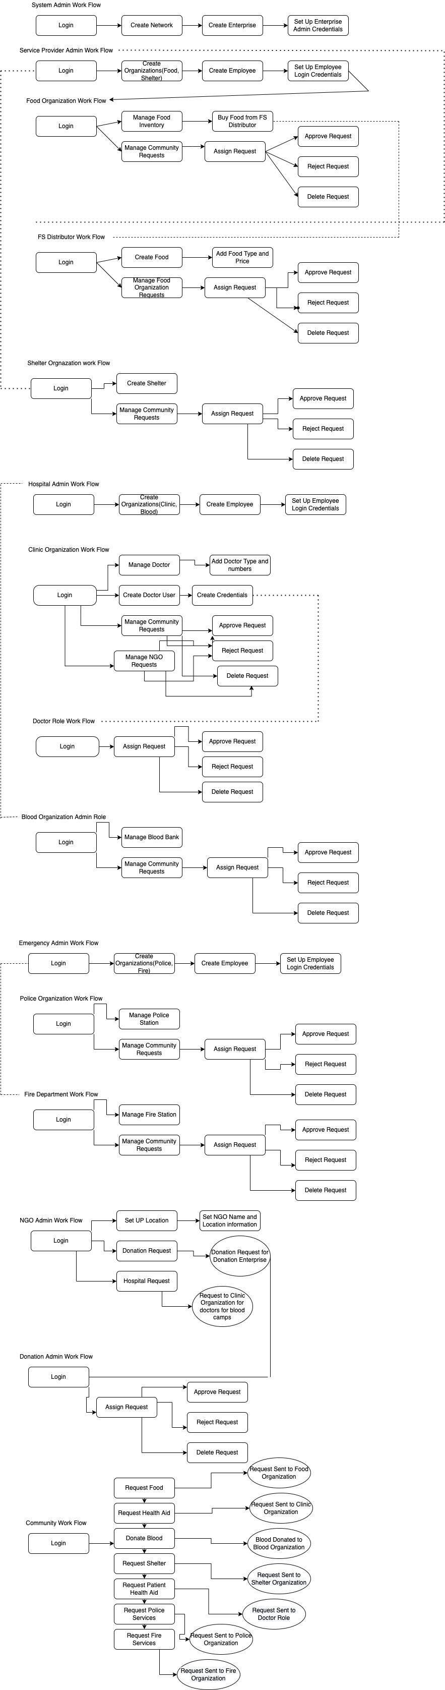
Flowchart

Slide 16
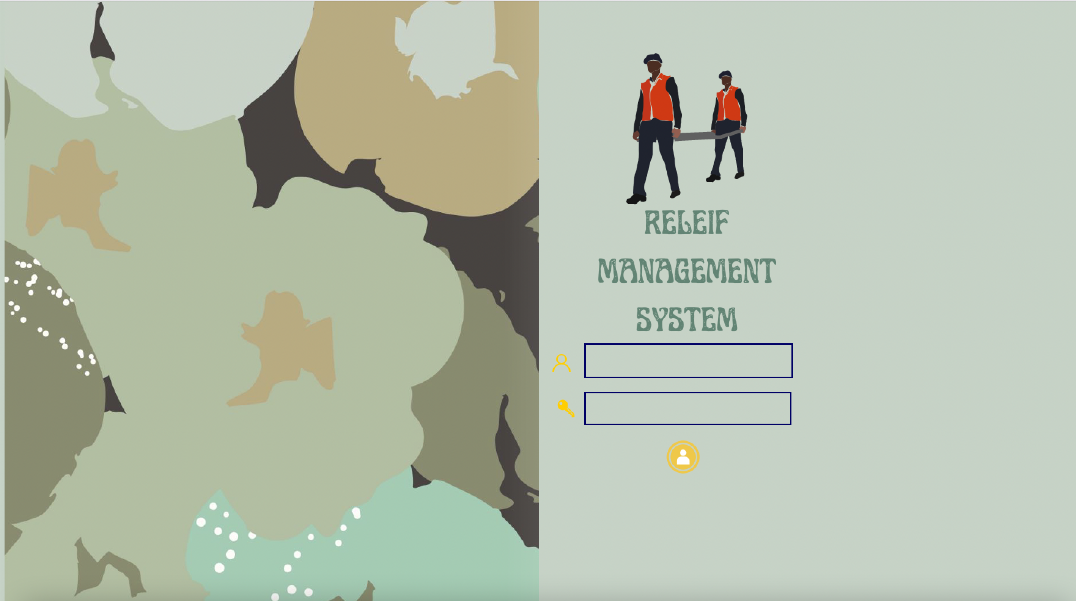
Home Page

Slide 17
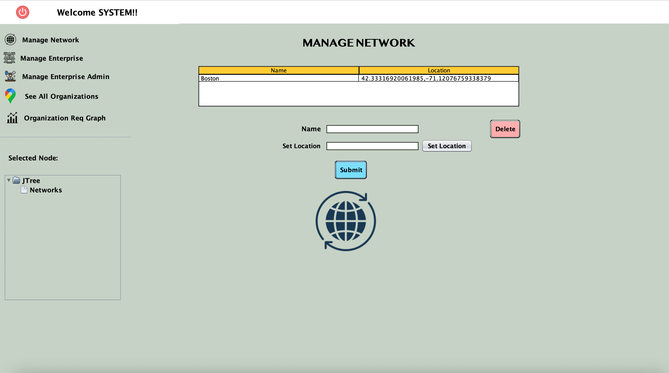
Manage Network

Slide 18
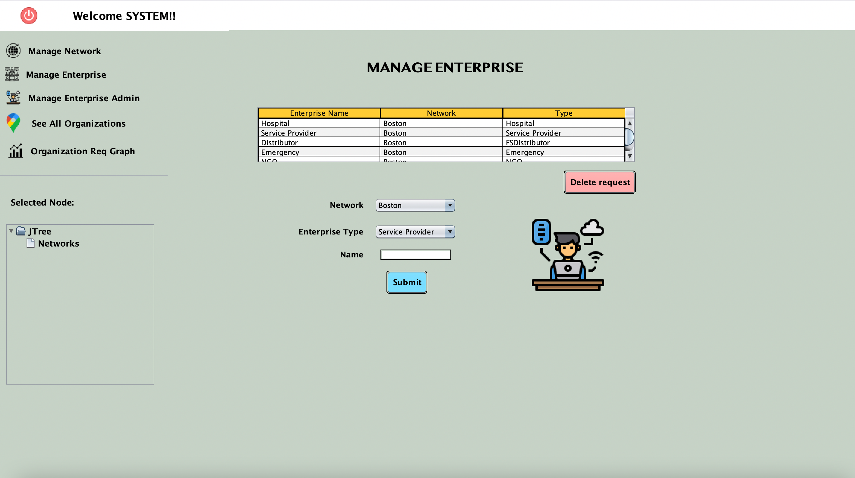
Manage Enterprise

Slide 19
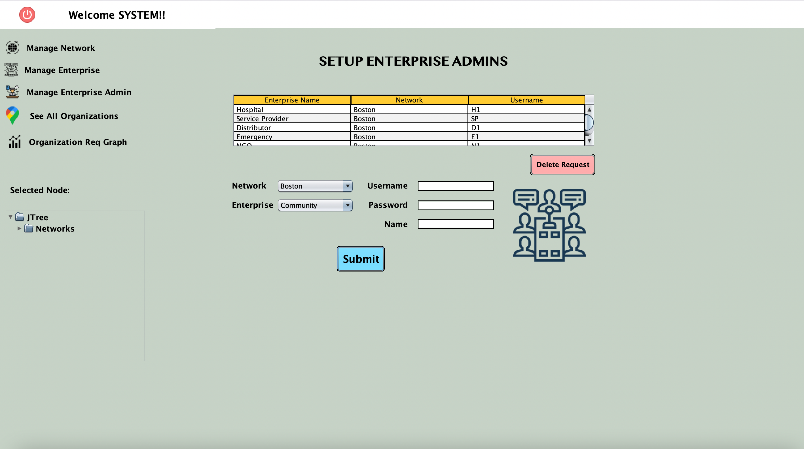
Manage User Accounts

Slide 20
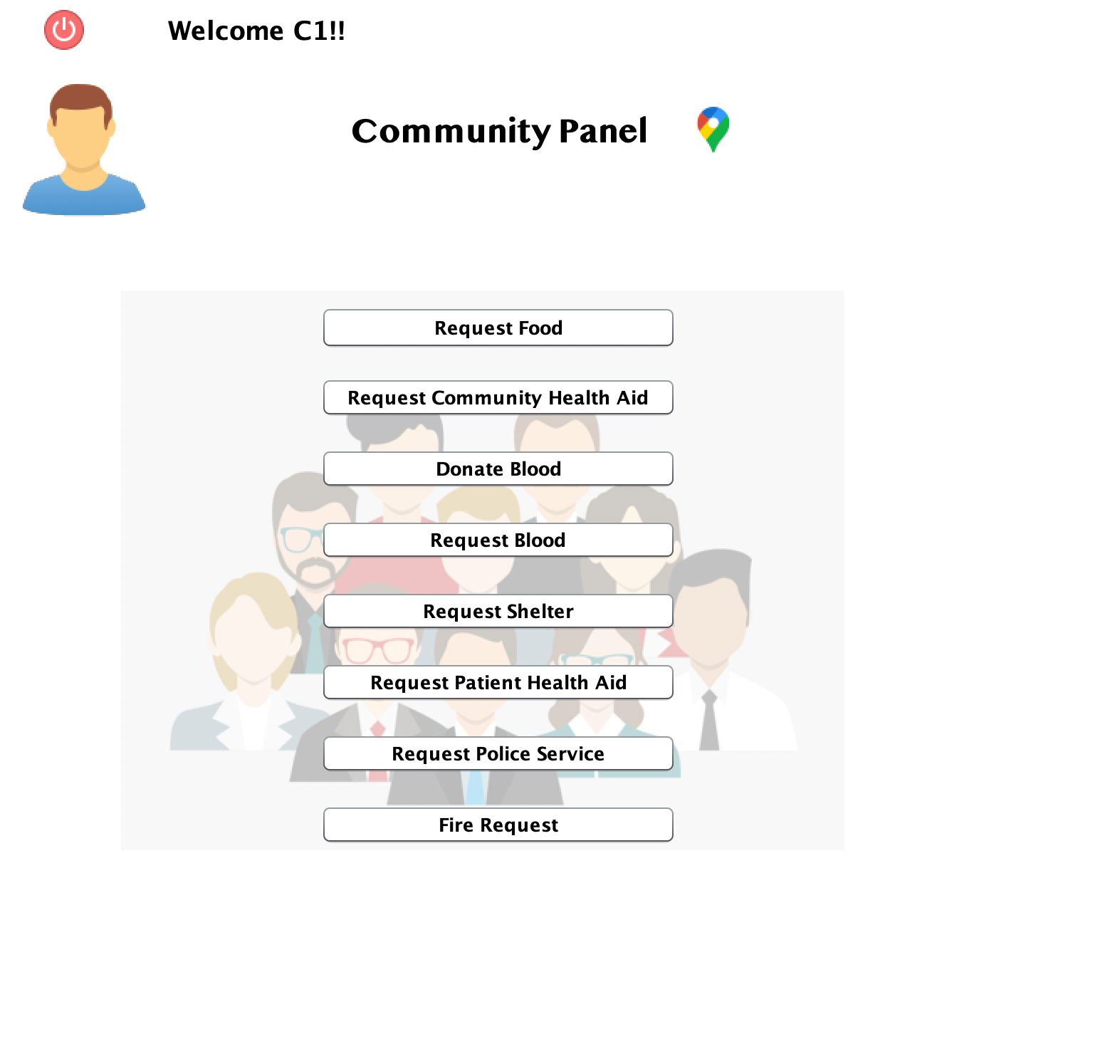
Community Request Panel

Slide 21
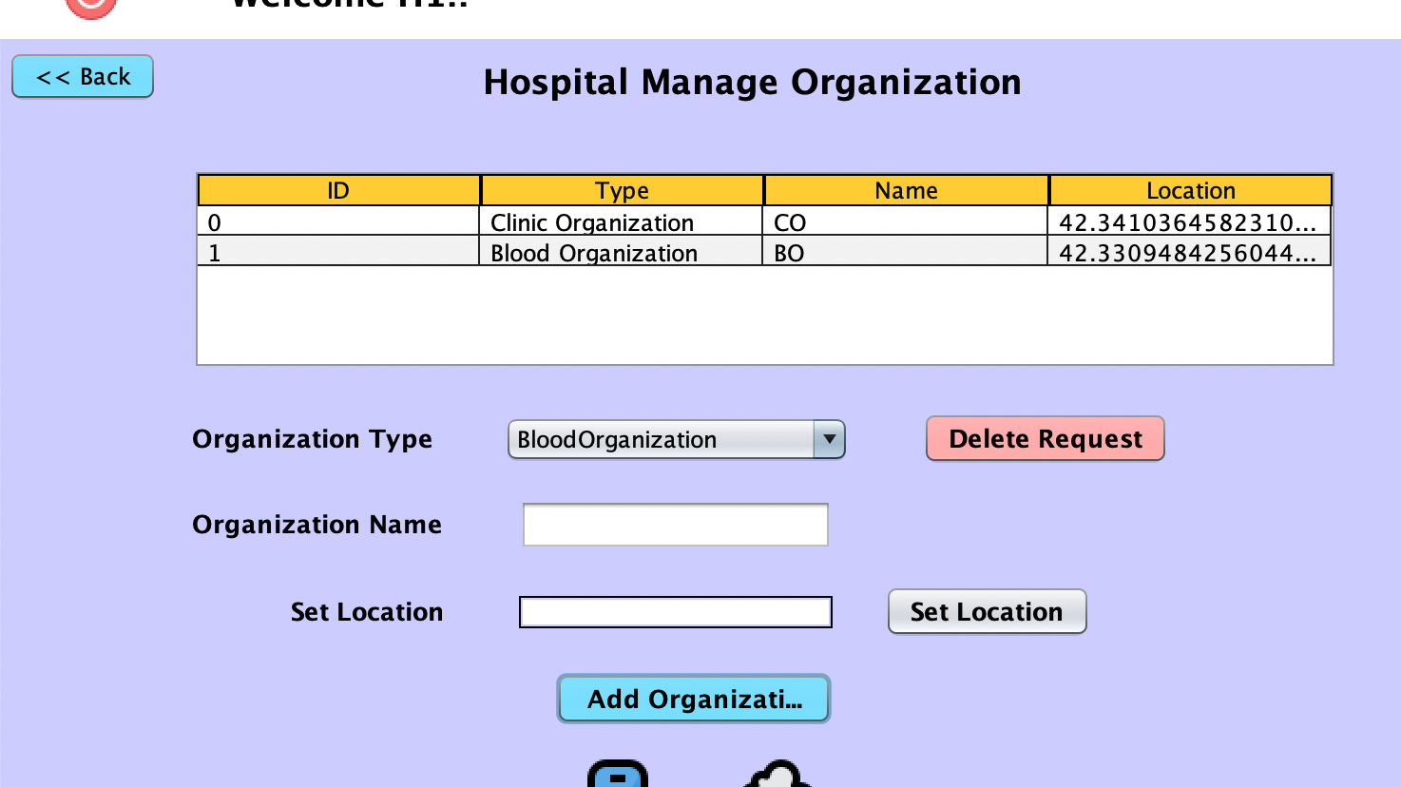
Hospital Organization

Slide 22
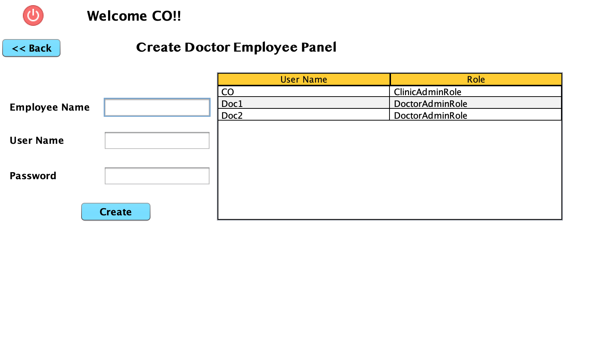
Create Doctor Panel

Slide 23
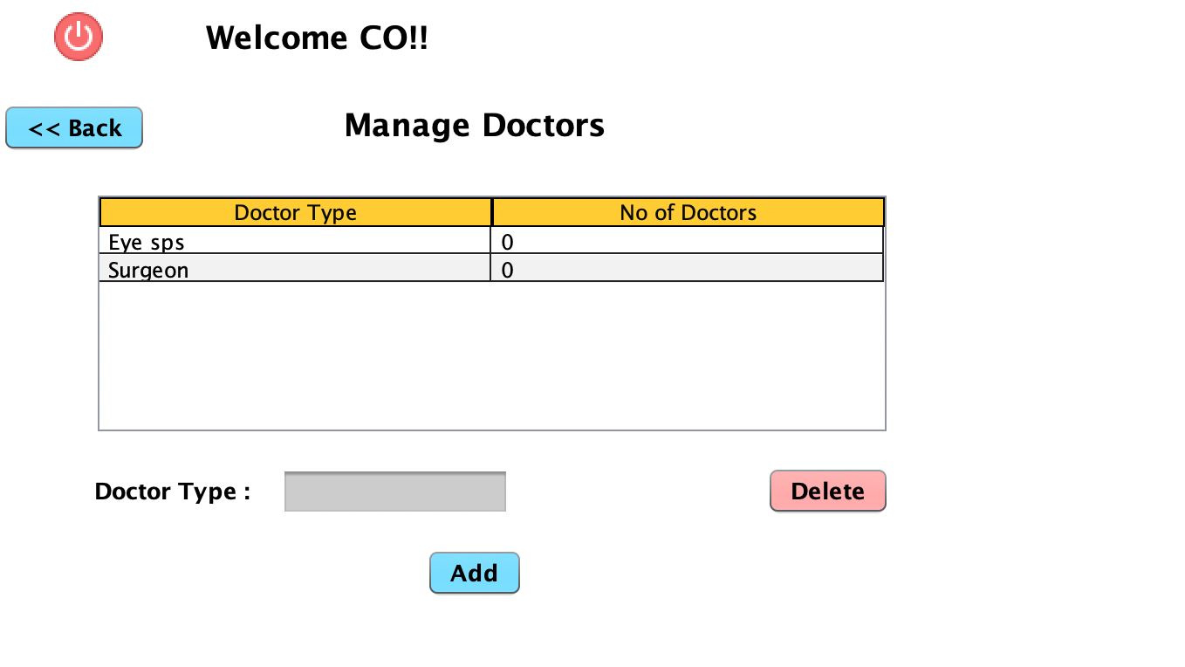
Manage Doctor Panel

Slide 24
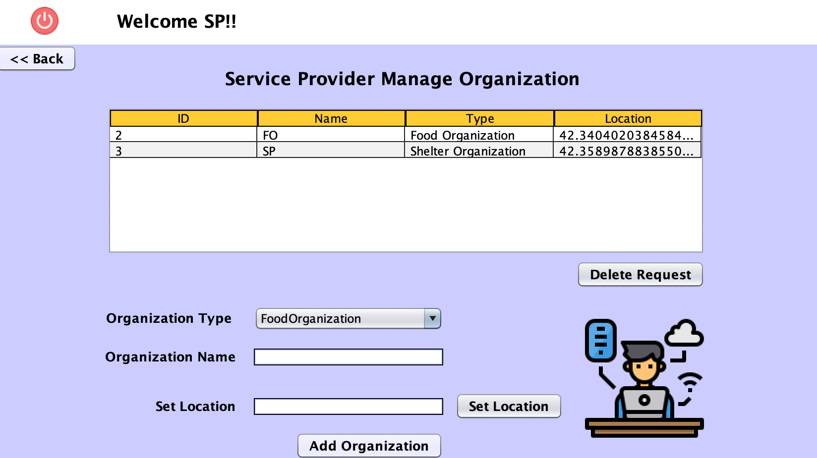
Service Provider Organization

Slide 25
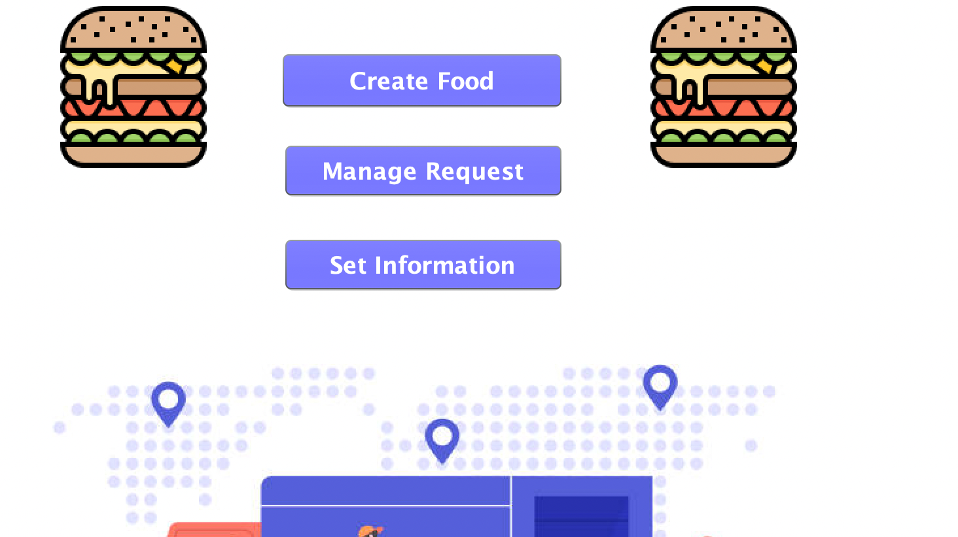
Distributor Panel

Slide 26
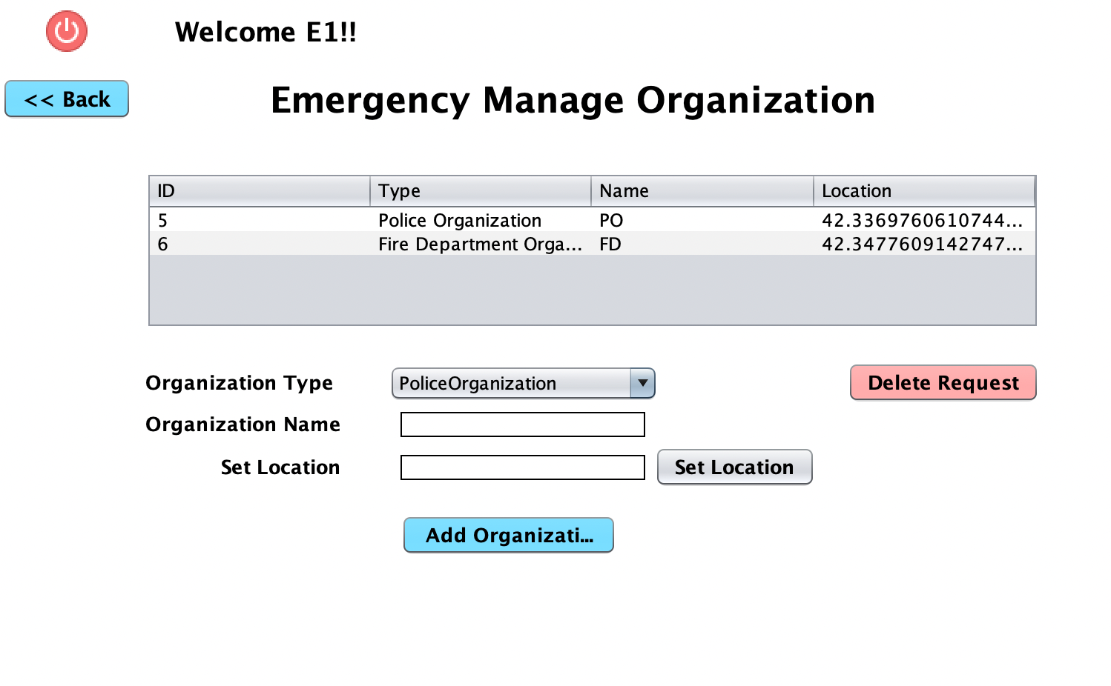
Emergency Organization

Slide 27
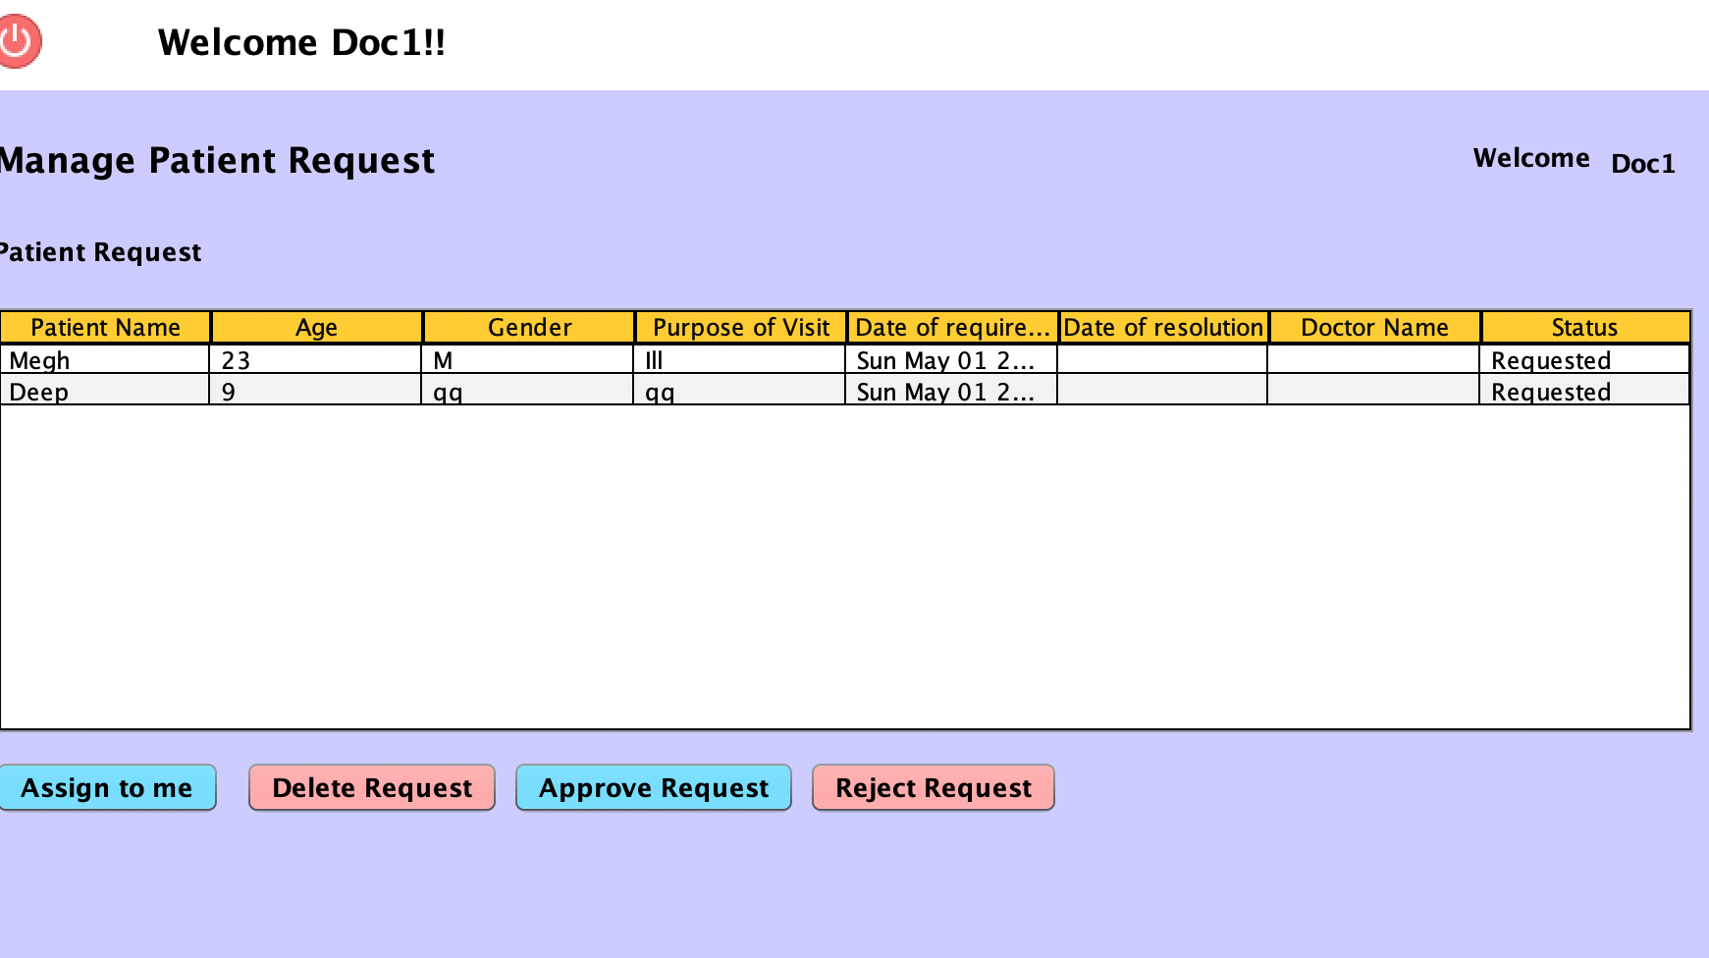
Doctor Role Panel

